Slide 1

Community as a means of sanctification

Slide 2
A. The Holy Spirit baptizes us into community.
1 Corinthians 12.13, 27 NIV: “For we were all baptized by one Spirit so as to form one body-- whether Jews or Gentiles, slave or free-- and we were all given the one Spirit to drink… Now you are the body of Christ, and each one of you is a part of it.”

Slide 3
A. The Holy Spirit baptizes us into community.
B. We are connected and belong to each other.
Romans 12.4-5 NET: “For just as in one body we have many members, and not all the members serve the same function, so we who are many are one body in Christ, and individually we are members who belong to one another.”

Slide 4
A. The Holy Spirit baptizes us into community.
B. We are connected and belong to each other.
C. We are to have unity with each other.
1 Corinthians 1.9-10 NET: “God is faithful, by whom you were called into fellowship with his son, Jesus Christ our Lord. I urge you, brothers and sisters, by the name of our Lord Jesus Christ, to agree together, to end your divisions, and to be united by the same mind and purpose.”

Slide 5
A. The Holy Spirit baptizes us into community.
B. We are connected and belong to each other.
C. We are to have unity with each other.
D. God sanctifies both individuals and the church.
The Fruit of the Spirit build the church’s community.
The Fruit of the Flesh destroy community.
[Galatians 5.19-23]

Slide 6
Ephesians 4.11-16 NET: “It was he who gave some as apostles, some as prophets, some as evangelists, and some as pastors and teachers, to equip the saints for the work of ministry, that is, to build up the body of Christ, until we all attain to the unity of the faith and of the knowledge of the Son of God– a mature person, attaining to the measure of Christ's full stature. So we are no longer to be children, tossed back and forth by waves and carried about by every wind of teaching by the trickery of people who craftily carry out their deceitful schemes. But practicing the truth in love, we will in all things grow up into Christ, who is the head. From him the whole body grows, fitted and held together through every supporting ligament. As each one does its part, the body grows in love.”

Slide 7
Ephesians 4.11-16 NET: “…to equip the saints for the work of ministry, that is, to build up the body of Christ, until we all attain to the unity of the faith and of the knowledge of the Son of God– a mature person, attaining to the measure of Christ's full stature. So we are no longer to be children, tossed back and forth by waves and carried about by every wind of teaching by the trickery of people who craftily carry out their deceitful schemes. But practicing the truth in love, we will in all things grow up into Christ, who is the head. From him the whole body grows, fitted and held together through every supporting ligament. As each one does its part, the body grows in love.”

Slide 8
Ephesians 4.11-16 NET: “…to equip the saints for the work of ministry, that is, to build up the body of Christ, until we all attain to the unity of the faith and of the knowledge of the Son of God– a mature person, attaining to the measure of Christ's full stature. So we are no longer to be children, tossed back and forth by waves and carried about by every wind of teaching by the trickery of people who craftily carry out their deceitful schemes. But practicing the truth in love, we will in all things grow up into Christ, who is the head. From him the whole body grows, fitted and held together through every supporting ligament. As each one does its part, the body grows in love.”

Slide 9
Ephesians 4.11-16 NET: “…to equip the saints for the work of ministry, that is, to build up the body of Christ, until we all attain to the unity of the faith and of the knowledge of the Son of God– a mature person, attaining to the measure of Christ's full stature. So we are no longer to be children, tossed back and forth by waves and carried about by every wind of teaching by the trickery of people who craftily carry out their deceitful schemes. But practicing the truth in love, we will in all things grow up into Christ, who is the head. From him the whole body grows, fitted and held together through every supporting ligament. As each one does its part, the body grows in love.”

Slide 10

God’s Plan A: to use other people to help us grow.
“Virtually every emotional and psychological problem, from addictions to depression, has alienation or emotional isolation at its core. Recovery from these problems always involves helping people to get more connected to each other at deeper and healthier levels than they are” [122].

Slide 11
God’s Plan A: to use other people to help us grow.
We are blessed more by…
 working together
 ministering to each other

Slide 12
God’s Plan A: to use other people to help us grow.
Growth leads to
flowering…
Good roots lead to
growth…
Our roots are
biblical community!

Slide 13
God’s Plan A: to use other people to help us grow.
ἀλλήλων [ahl-LAY-lone] = one another
Growth leads to
flowering…
Good roots lead to
growth…
Our roots are
biblical community!

Slide 14
We love one another
John 15.12 NET: “My commandment is this– to love one another just as I have loved you.”
We forgive one another
Colossians 3.12-13 NET: “Therefore, as the elect of God, holy and dearly loved, clothe yourselves with a heart of mercy, kindness, humility, gentleness, and patience, bearing with one another and forgiving one another, if someone happens to have a complaint against anyone else. Just as the Lord has forgiven you, so you also forgive others.”

Slide 15
We accept one another unconditionally
Romans 15.7 NIV: “Accept one another, then, just as Christ accepted you, in order to bring praise to God.”
We exhort one another to follow Christ
Hebrews 3.13 NET: “But exhort one another each day, as long as it is called ‘Today,’ that none of you may become hardened by sin's deception.”
We teach and admonish each other
Colossians 3.16 NASB: “Let the word of Christ richly dwell within you, with all wisdom teaching and admonishing one another…

Slide 16
We encourage and edify one another
1 Thessalonians 5.11 NET: “Therefore encourage one another and build up each other…”
We serve and help one another
1 Peter 4.10 NET: “Just as each one has received a gift, use it to serve one another as good stewards of the varied grace of God.”
We show devotion to one another
Romans 12.10 NET: “Be devoted to one another with mutual love, showing eagerness in honoring one another.”

Slide 17
We enthusiastically greet one another
1 Peter 5.14 NET: “Greet one another with a loving kiss.”
We care for one another
Philippians 2.3-5 NET: “Instead of being motivated by selfish ambition or vanity, each of you should, in humility, be moved to treat one another as more important than yourself. Each of you should be concerned not only about your own interests, but about the interests of others as well. You should have the same attitude toward one another that Christ Jesus had.”

Slide 18
We are patient with one another
Ephesians 4.1-3 NET: “I, therefore, the prisoner for the Lord, urge you to live worthily of the calling with which you have been called, with all humility and gentleness, with patience, bearing with one another in love, making every effort to keep the unity of the Spirit in the bond of peace.”
We are kind to one another
Ephesians 4.32 NET: “…be kind to one another, compassionate, forgiving one another, just as God in Christ also forgave you.”

Slide 19
We comfort one another
1 Thessalonians 4.18 NASB: “Therefore comfort one another with these words [of scriptural truth].”
We pursue what is good for one another
1 Thessalonians 5.15 NET: “See that no one pays back evil for evil to anyone, but always pursue what is good for one another and for all.”

Slide 20
We work to restore one another
Galatians 6.1-2 NET: “Brothers and sisters, if a person is discovered in some sin, you who are spiritual restore such a person in a spirit of gentleness. Pay close attention to yourselves, so that you are not tempted too. Carry one another's burdens, and in this way you will fulfill the law of Christ.”

Slide 21
We pray for one another and confess to one another
James 5.16 NET: “So confess your sins to one another and pray for one another so that you may be healed. The prayer of a righteous person has great effectiveness.”

Slide 22
We pray for one another and confess to one another
James 5.16 NET: “So confess your sins to one another and pray for one another so that you may be healed. The prayer of a righteous person has great effectiveness.”
 prayer support
 emotional and spiritual healing
 exhortation and encouragement
 unconditional grace, acceptance, love

Slide 23
We accept one another unconditionally
Romans 15.7 NIV: “Accept one another, then, just as Christ accepted you, in order to bring praise to God.”
 If you are accepted by others then you can be authentic and open to real relationships.
 As you learn to accept others, you become more like Christ.

Slide 24
Hebrews 10.24-25 NIV: “And let us consider how we may spur one another on toward love and good deeds, not giving up meeting together, as some are in the habit of doing, but encouraging one another-- and all the more as you see the Day approaching.”

Slide 25
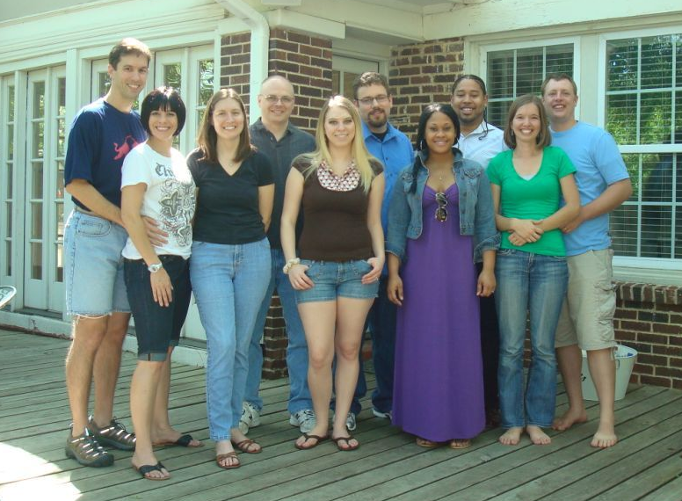
Community as a means of sanctification

